Slide 1

Subsequence
Team SCV – Chu Jae Hun

Slide 2
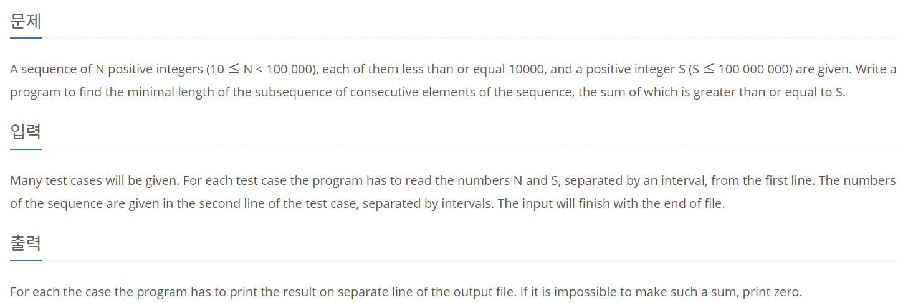
About Problem..
Ex) N = 10, S = 15
5 1 3 5 10 7 4 9 2 8
=> 2

Slide 3
Idea..
[0]
[1]
[2]
[3]
[4]
[5]
[6]
[7]
[8]
[9]
‘Left’, ‘Right’ start from 0
Determine by increasing ‘Right’
If exceed -> left += 1
5 1 3 5 10 7 4 9 2 8

Slide 4
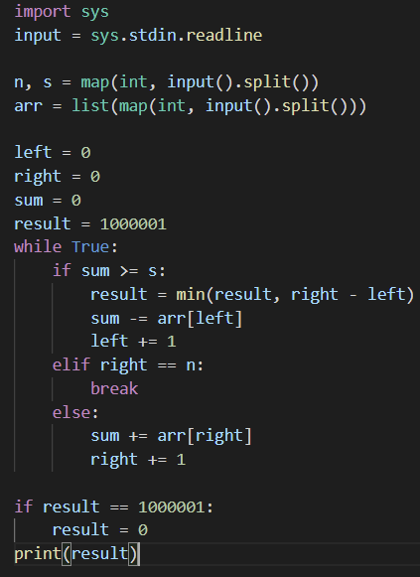
Procedure..
Input
result(to get min)
Renew the minimum (if left to right is less than current min)

Slide 5
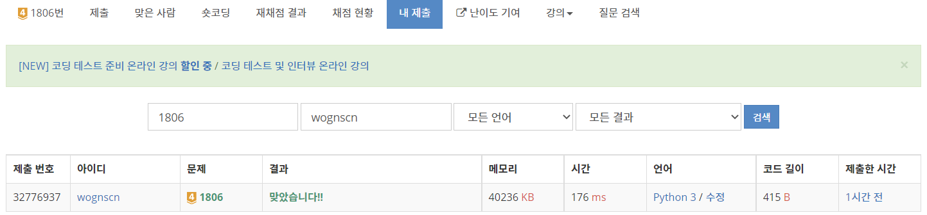
Result/Feedback

